Slide 1

Secondary Suites
Hantsport
April 22, 2021

Slide 2
Application
In the fall of 2020, the West Hants Housing Coalition approached West Hants Regional Municipality (WHRM) staff to consider options to improve the amount of affordable housing in the Region.
Staff categorized options as short, medium, and long-term depending on the amount of staff time required.
One of the short-term options was to permit secondary suites in single and two-unit dwellings and align the definition of secondary suites with the National Building Code (NBC) definition.
On December 11, 2020 the Family Resource Centre, which is a member of the West Hants Housing Coalition and located in Windsor, applied for the amendment to all planning documents in West Hants Regional Municipality

Slide 3
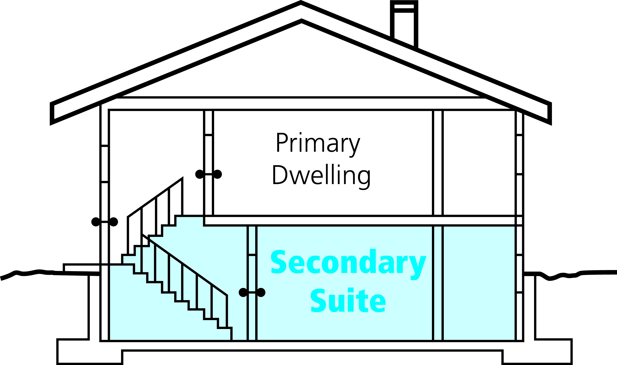
What is a Secondary Suite?
https://www.vaughan.ca/services/secondary_suites/Pages/About.aspx

Slide 4
National Building Code (NBC)
A secondary suite as defined in the NBC is a self-contained dwelling unit with a limited floor area which is contained within a house or another building which contains only residential occupancies. The Secondary Suite and the Main Suite must constitute a single real estate entity.
The size of a suite is limited to 80% of the total floor area of the main dwelling unit or a maximum of 861 ft² (80 m²).
The Hantsport Municipal Planning Strategy (HMPS) does not permit secondary suites or accessory apartments.
On February 23, Council approved in principle all recommendations presented in the RAD Consulting report. Recommendation 12 encourages Council to address affordable housing by considering options such as secondary suites. This indicates Council would like to consider secondary suites in the Region.

Slide 5
Policy
Policy IM-3 states general criteria in Hantsport for amendments.

Slide 6
Staff Review
Public Information Meeting – April 22
Public Hearing held and adjourned to next meeting of Council (June 22*)
PAC receives staff report and PIM Notes
PAC Review and Recommendation – May 13
Regional Council First Reading (May 25*)
Council completes Public Hearing and holds Second Reading (July 27*)
Notice of Approval in Local Paper
Ministerial Approval
Process
Notice was placed in the local paper, Facebook, and the Municipal Website.
*anticipated dates final dates will be set by Council

Slide 7
Process
Comments and questions can be submitted by the public until May 6th
All correspondences should be sent to:
Planner Shah
Phone | 902-798-8391 ext. 118
Email | sshah@westhants.ca
Mail | 76 Morison Drive, PO Box 3000 Windsor NS B0N 2T0
Drop box | Regional office at 76 Morison Drive

