Slide 1


Slide 2
Meadows Development, Falmouth
Development Agreement
Public Hearing
April 27, 2021

Slide 3
Application
Brison Developments Limited applied for a development agreement to permit two-unit residential development in Falmouth.
On December 11, 2020 the applicant requested that staff consider three and four-unit dwellings in addition to the two-unit dwellings requested; this request was withdrawn on February 23, 2021.
There is a registered development agreement for one (1) of the properties from August 2007 to permit eight (8) semi-detached dwellings. Brison Developments Limited wishes to discharge that agreement.

Slide 4
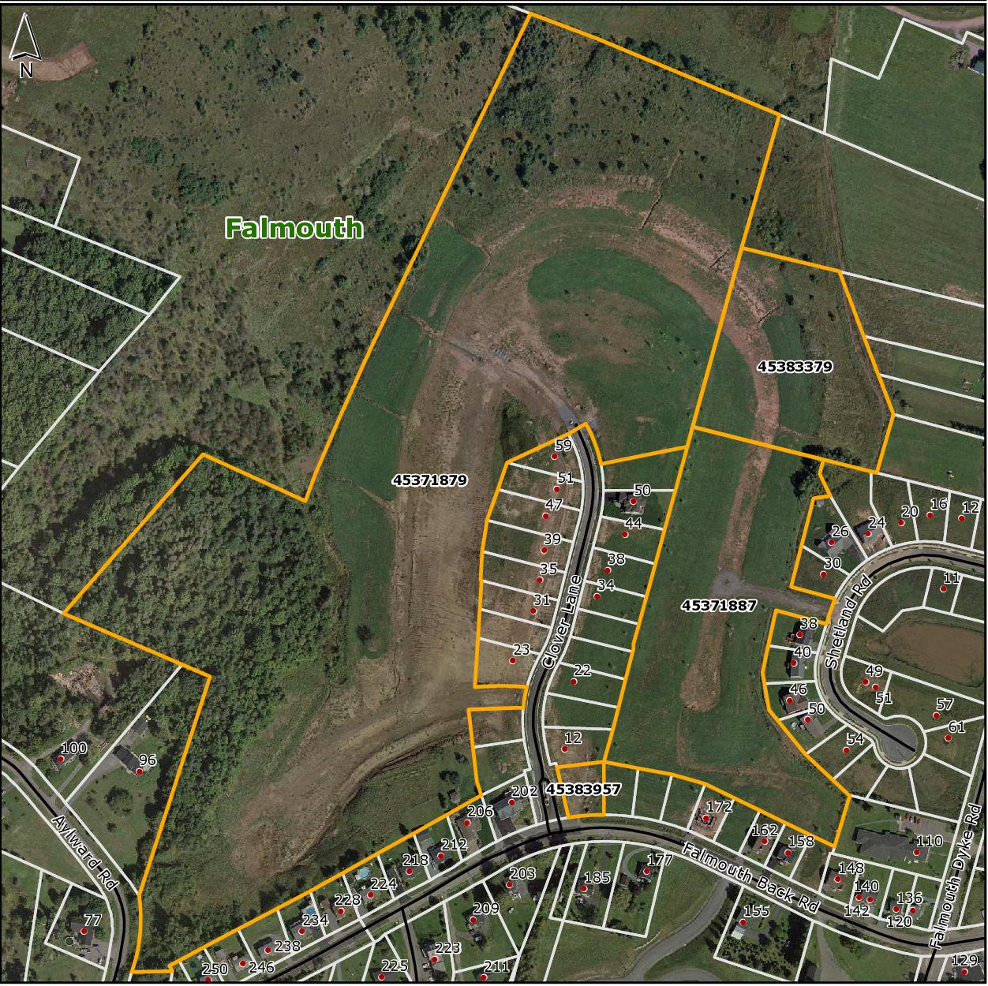
Orthophoto Map

Slide 5
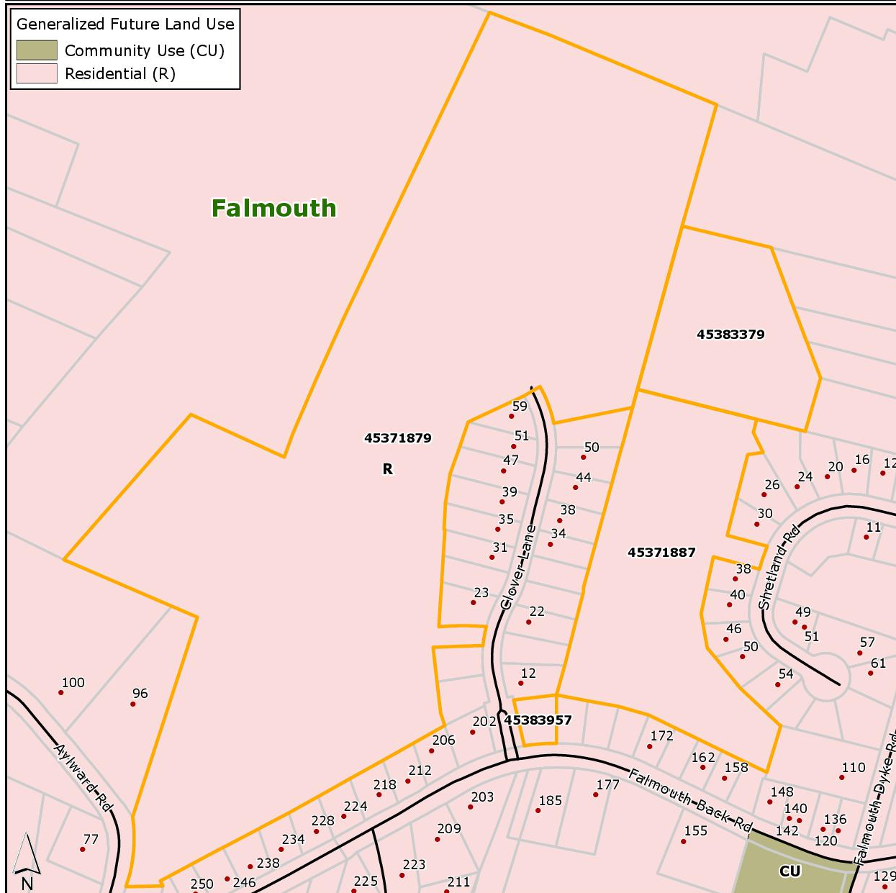
Generalized Future Land Use Map

Slide 6
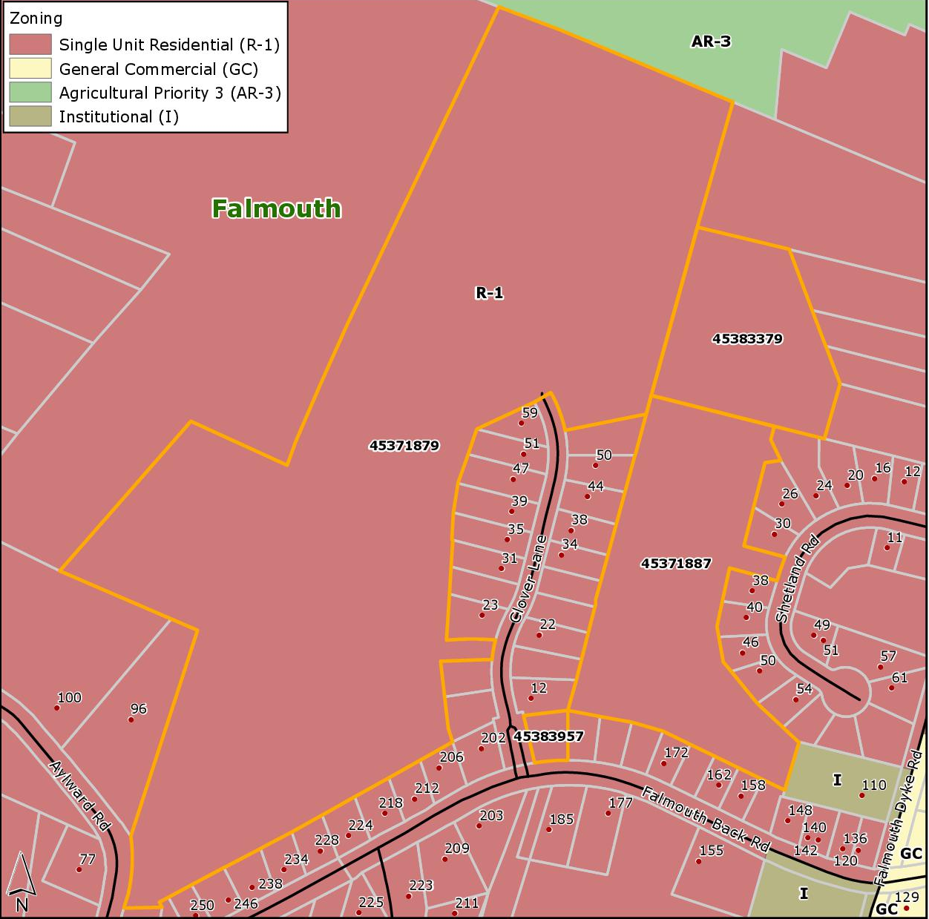
Existing Zoning Map

Slide 7
Policy
A development agreement (DA) is a legal contract between the Municipality and a property owner to permit a use that is not permitted in the underlying zone
Policy 5.4.4 enables Council to consider proposals for comprehensively designed multiple residential developments in the Falmouth Growth Centre by development agreement
Policy 16.3.1 states general criteria in West Hants

Slide 8
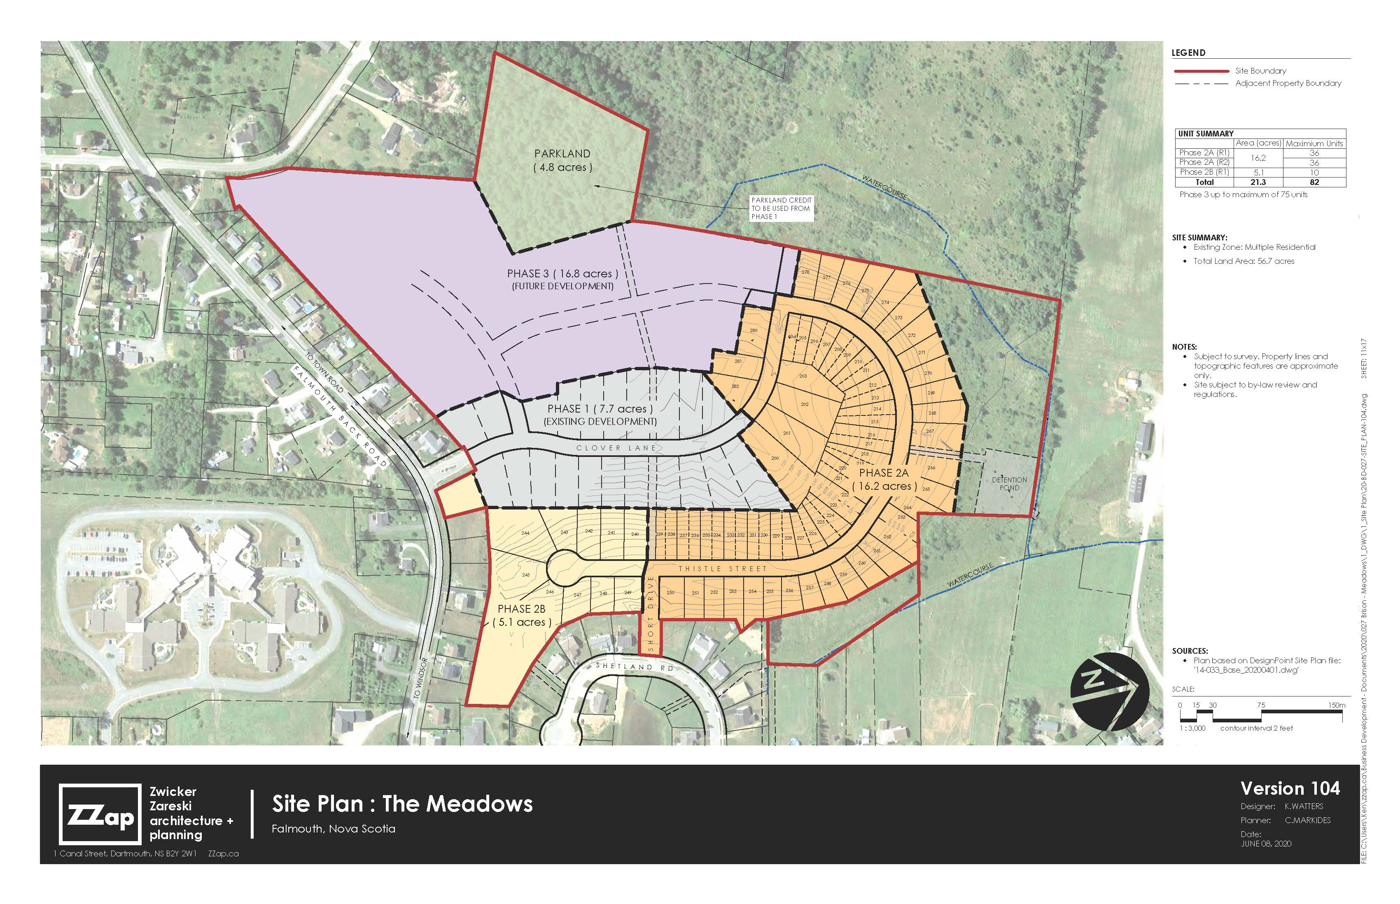

Slide 9
WHMPS Specific Criteria Policy 5.4.4
In summary, the criteria are met since:
  the DA has specific stipulations for density and ensures that a minimum of 30 percent of the total number of dwelling units will be single unit dwellings;
  a traffic impact study will be required before the 100th residential unit development permit can be issued or before any development can start in Phase 3 and all work required by the recommendations in the TIS must be completed;
  the reduced setback requirements will enable a planned compact community that makes efficient use of streets and municipal infrastructure; and
  the stormwater management plan is considered satisfactory by the Municipal Engineer.

Slide 10
WHMPS General Criteria Policy 16.3.1
In summary:
  the proposal is not premature or inappropriate for the area;
  there would be an increase in households using water, sewer, and waste disposal services in the area. New residents moving to the development would be expected to cover some of the increased costs for the Municipality; and
  the Fire Chief, Manager of Building and Fire Inspections Services, Director of Public Works and Department of Transportation and Infrastructure Renewal have no major concerns which have not been address in the draft development agreement.

Slide 11
Planning Advisory Committee
A Public Information Meeting was held on January 19, 2021
PAC recommended in favour of the proposed development agreement on March 11, 2021.
PAC discussed additional requirements to try to ensure there is variation in the design of the dwellings but after the applicant clarified the design elements are predominantly determined by the prospective property owner, PAC recommended the development agreement as drafted.

Slide 12
Council First Reading
On March 23, 2021, Staff presented three (3) proposed changes to the development agreement:
  that the most recent stormwater management plan be attached to the DA;
  that the minimum flankage yard requirement for single unit dwellings on corner lots be reduced from 25 ft. to 15 ft.; and
  that the Development Officer, in consultation with the Municipal Engineer, can consider minor changes to the stormwater management plan without an amendment to the DA.
Council voted to hold a Public Hearing for the development agreement with the additions noted above.

Slide 13
Staff Review
Public Information Meeting
Public Hearing held and adjourned to next meeting of Council (April 27)
14 Day Appeal period
PAC receives staff report and PIM Notes
PAC Review and Recommendation
Regional Council First Reading
Council completes Public Hearing and holds Second Reading (May 25)
Notice of Approval in Local Paper
Process
Notice was placed in the local paper and website/Facebook
Letters were mailed to residents within 500 ft. of the property.

Slide 14
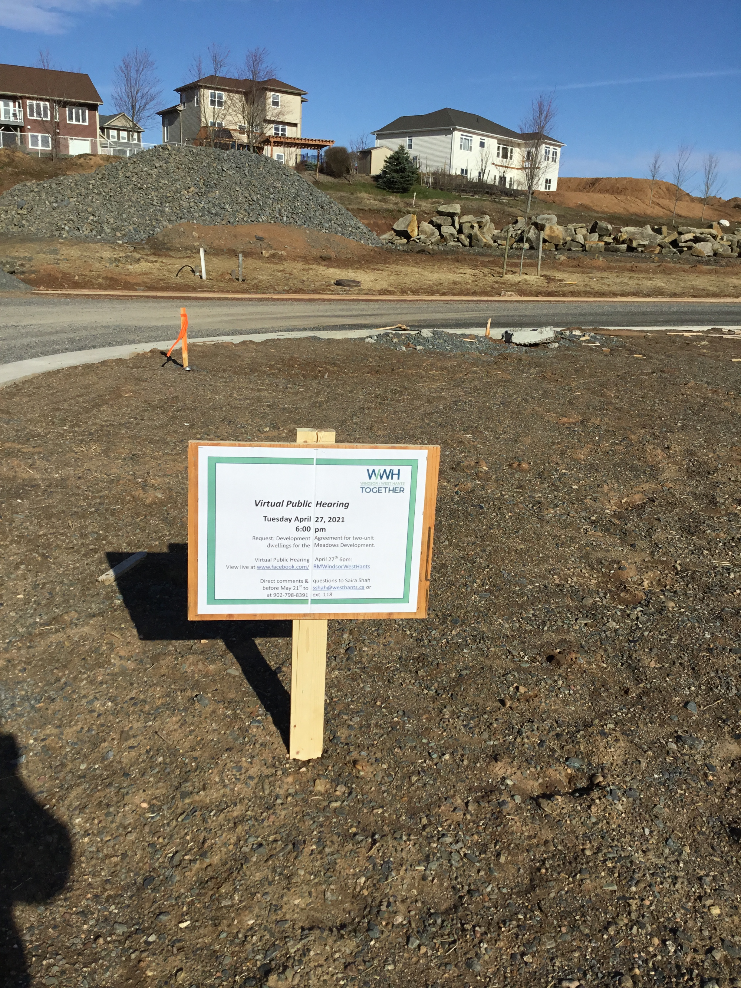
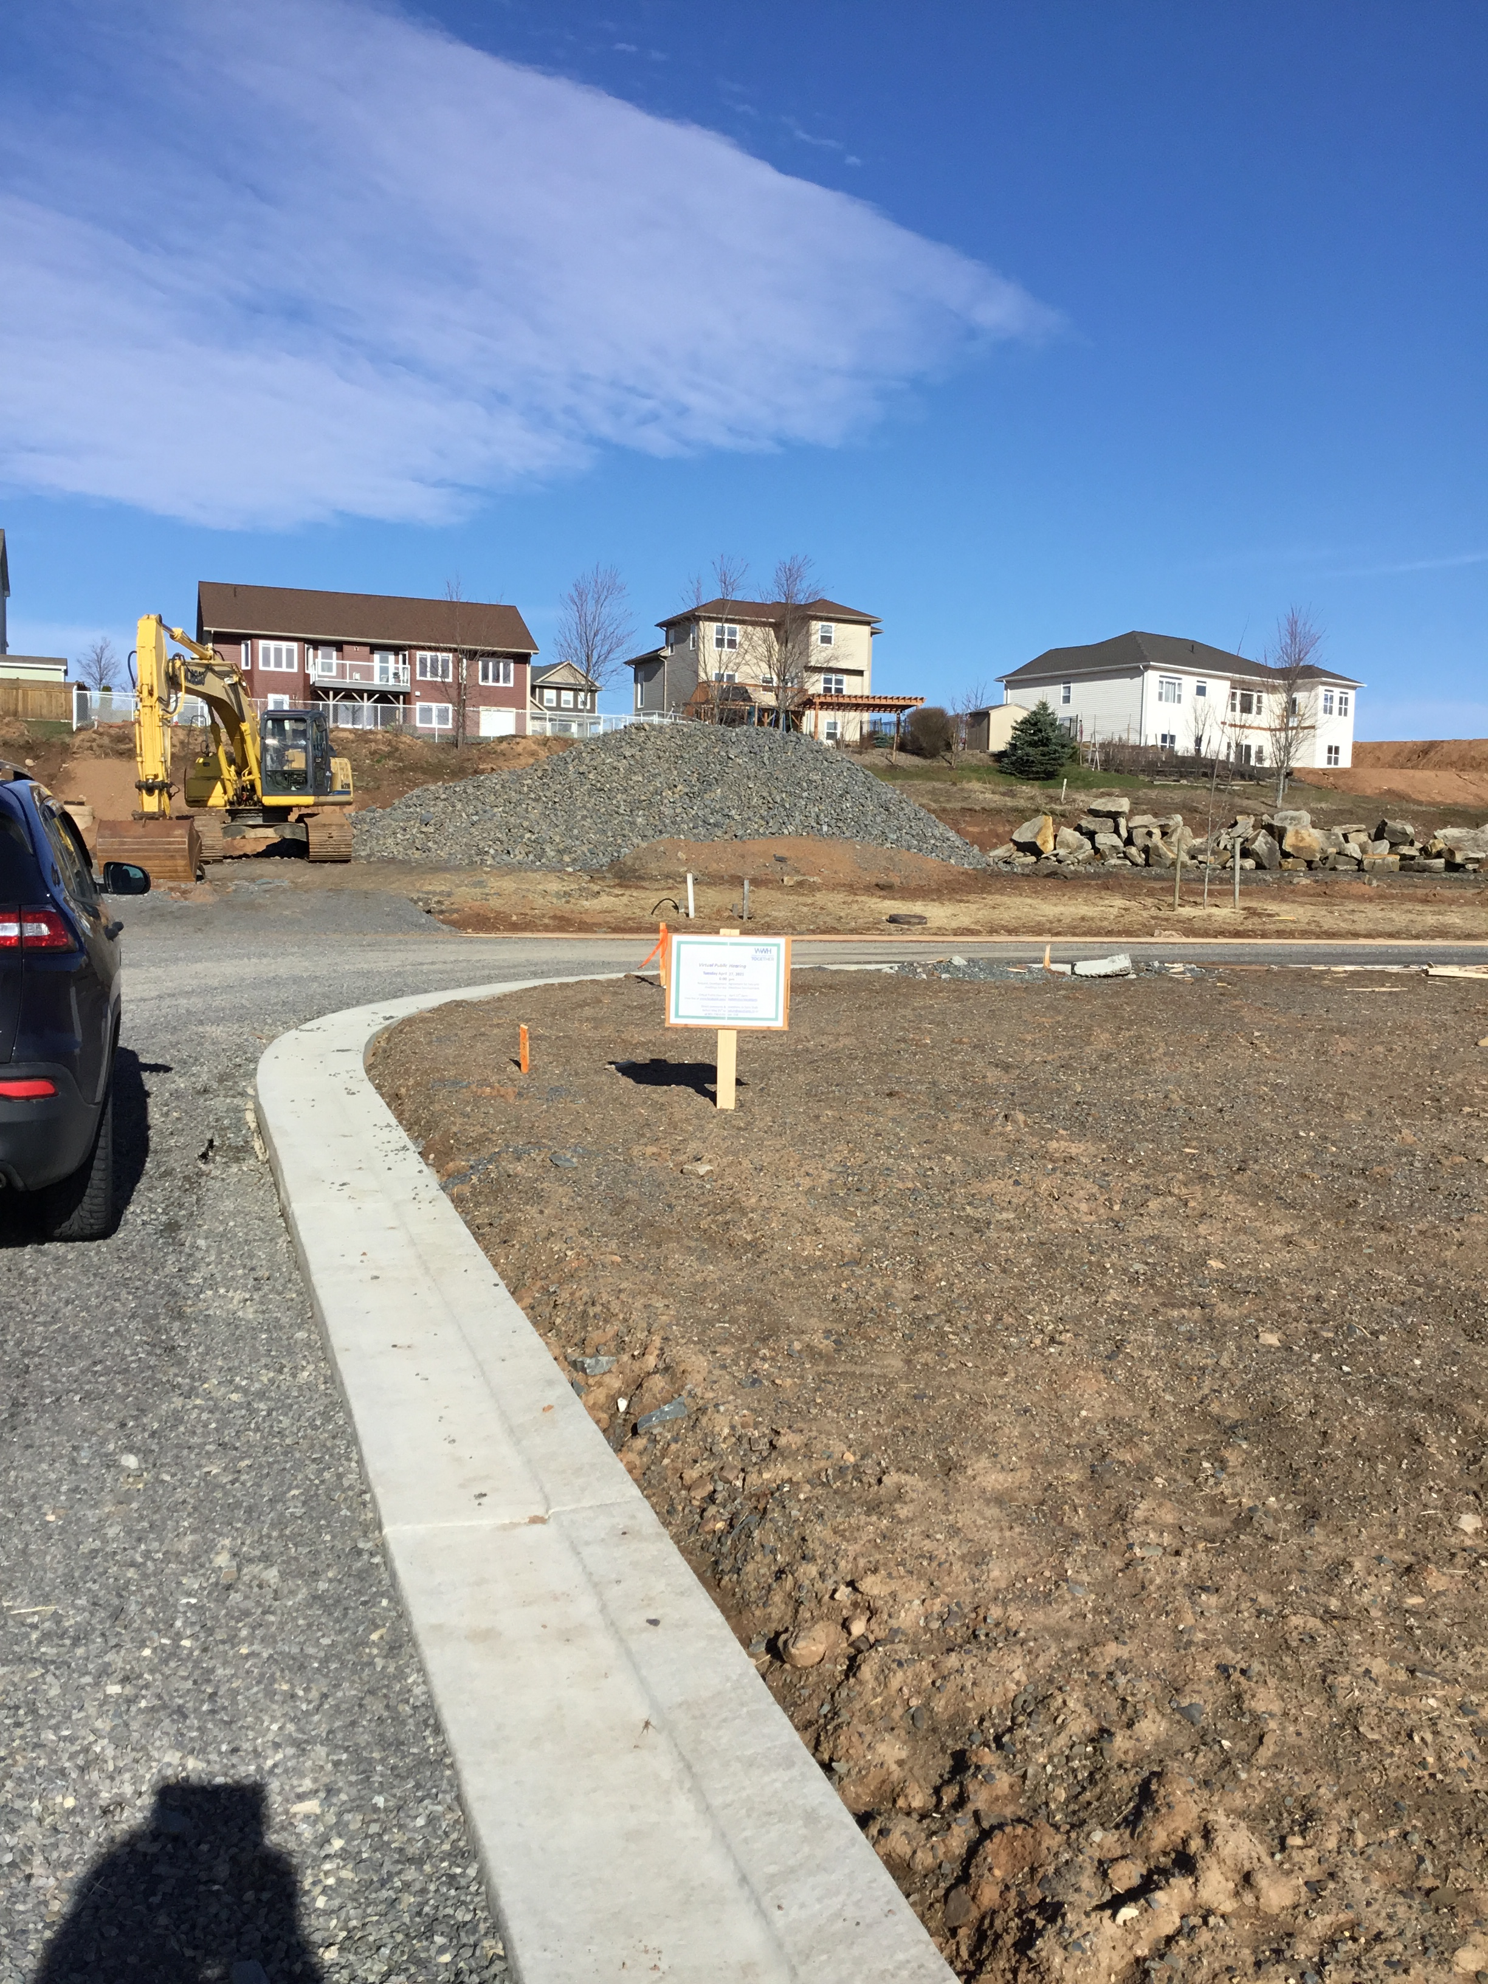

Slide 15
Parkland
A resident has asked for clarification about the parkland contribution
Parkland requirements set out in Policy 5.4.4 (d) are in the DA
  5% required for parkland for less than 3 dwelling units per acre
  10% required for parkland for 3 or more dwelling units per acre
  Development cannot exceed 4 and half dwelling units per acre
Based on the existing parkland agreements and the concept plan submitted by the applicant 4.8 acres has been allocated within the Meadows Development as parkland

Slide 16
Parkland Cont.
Based on a maximum build out scenario, 70% of the development can be two-unit dwellings which would likely exceed 3 dwelling units per acre
If 70% is two-unit dwellings which require a 10% parkland contribution:
Total Area of the Site
70% of the Total Area
Total Parkland Required
45.8 acres X 70%
= 32.06 acres
32.06 acres x 10%
= 3.206 acres
45.8 acres

Slide 17
Parkland Cont.
If 30% is single-unit dwellings which require a 5% parkland contribution:
Total Area of the Site
30% of the Total Area
Total Parkland Required
45.8 acres X 30%
= 13.74 acres
13.74 acres x 5%
= 0.687 acres
45.8 acres

Slide 18
Parkland Cont.
Total parkland requirement in the maximum build out scenario is 3.89 acres which is less than the 4.8 acres allocated by the applicant in the concept plan
This is an initial assessment provided by the Development Officer the final requirement would be determined during the subdivision process
Any streets and right-of-ways would be taken out of that calculation making the requirement under 3.89 acres

Slide 19
Process
Comments and questions can be submitted by the public until May 21st
All correspondences should be sent to:
Planner Shah
Phone | 902-798-8391 ext. 118
Email | sshah@westhants.ca
Mail | 76 Morison Drive, PO Box 3000 Windsor NS B0N 2T0
Drop box | Regional office at 76 Morison Drive

